Slide 1
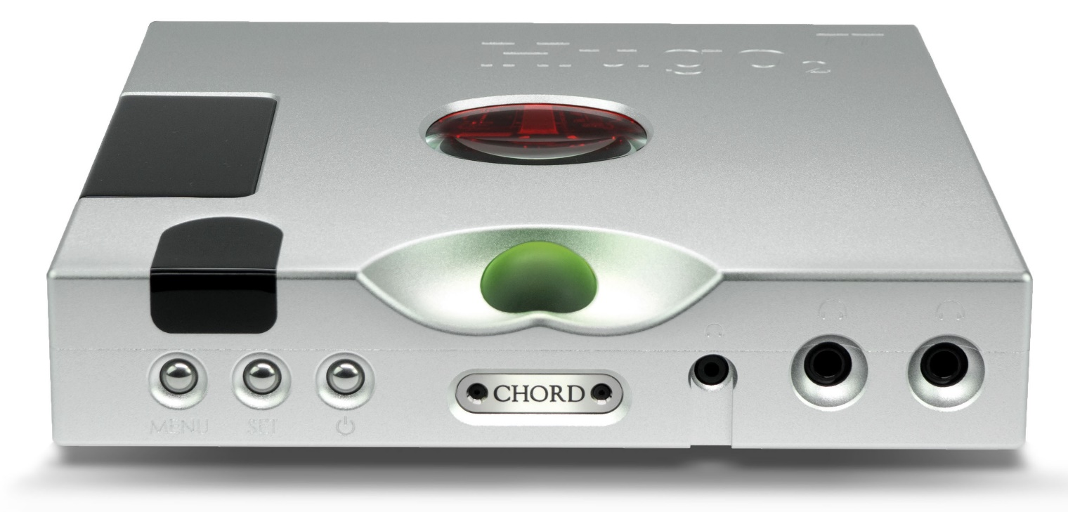
Hugo TT 2 technical summary
An introduction into Rob Watts’ technology that is in Hugo TT 2
Copyright Rob Watts 2018

Slide 2
Time Domain
The primary purpose of a DAC is to reproduce the un-sampled continuous analogue waveform from sampled digital data
Conventional DACs do a poor job of reproducing the original continuous analogue signal, with timing errors on transients
The ear/brain is extremely sensitive to extremely small timing errors:
Timing accuracy upsets the perception of the start and stopping of notes
It also degrades the ability to perceive instrument timbre and power
It degrades soundstage precision
The WTA algorithm does a much more accurate job of reproducing the timing of transients giving improved bass definition, timbre variation, soundstage and better instrument separation and focus

Slide 3
Timing – WTA filters
Hugo TT 2 has 98,304 tap 16FS WTA 1 filter.
It uses 86 208MHz DSP cores in parallel to create the WTA filters
Following the first WTA filter is a second WTA filter going from 16FS to 256 FS
This further improves timing reconstruction accuracy as the WTA 2 filter recovers timing to 81 nS resolution
Filter options – HF filter, 16FS WTA only or 16FS and 256FS filter to adjust the sound for taste – warm and soft or transparent and incisive
HF filter is separate option set to 40 kHz -3dB

Slide 4
Noise floor modulation
Noise floor modulation occurs when noise increases/decreases depending upon the music signal.
The ear/brain is extremely sensitive to this problem as it interferes with the brain’s ability to separate sounds into individual entities
Listening tests have shown sensitivity to noise floor modulation well below levels that are measureable
Noise floor modulation makes the sound hard, bright and aggressive; it degrades instrument separation and focus; reducing noise floor modulation improves sense of focus, smoothness and refinement – it sounds much more natural

Slide 5
Hugo TT 2 and noise floor modulation
The DAC architecture has a large influence on noise floor modulation – pulse array DAC’s have innately very low levels of modulation
The reference power supply to the DAC is crucial, this is very low noise and low impedance, with individual references per channel
RF noise is a major problem as it inter-modulates with the analogue electronics causing noise floor modulation – extensive RF filtering is employed, together with steps to reduce the analogue sensitivity
Quad layer ground planes are used, so that ground induced noise and distortion is eliminated
Jitter is a big source of noise floor modulation – incoming jitter is eliminated by a digital phase lock loop (DPLL).
Hugo TT 2 has extremely low noise floor of -178 dB with no measurable noise floor modulation

Slide 6
Hugo TT 2 noise shapers
The noise shaper is crucial for performance, particularly for accurate depth perception
Hugo TT 2 has 10 Pulse Array elements
The noise shaper is much improved; its now 12th order, running at 104 MHz, with better than 300 dB performance – well over 100,000 times more resolution than before
This ensures much better detail resolution and perception of sound-stage depth

Slide 7
Output drive
Hugo TT 2 has a very high power discrete OP stage integrated into the DAC output amplifier and filter
It features second order noise shaping analogue section; this reduces distortion with load
Hugo TT 2 has a fully regulated boost PSU voltage to enable greater power output into low impedance loads
Hugo TT 2 has 6 super-caps on the + and – 15 V power rails with 30 Farad capacity which ensures huge and linear dynamic current outputs
It is capable of 9.3 V RMS and peak output currents of 5 A
The OP stage has an extremely low output impedance with highly linear current delivery
Balanced OP stage via XLR with full very high power discrete OP for both outputs

Slide 8
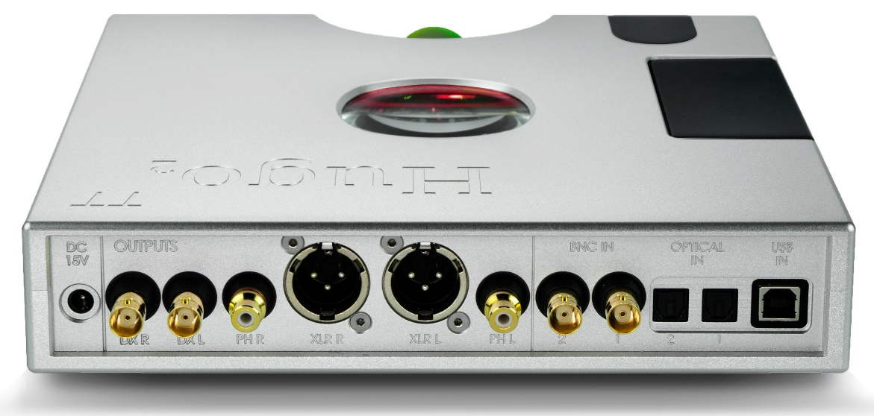
Hugo TT 2 versatility
Can be used in pure DAC mode
Plugging in headphones enables HP mode
Can be used in AMP mode as digital pre-amp, or directly driving efficient loudspeakers
Cross-feed may be configured in all modes
Low gain or high gain modes – so ultra sensitive IEM’s or power hungry headphones may be driven perfectly
Topology is still simple – even though powerful outputs, still 2 resistors, two capacitors and one global feedback path – so connection from digital domain to analogue is very direct for maximum transparency
Digital DC servo so fully DC coupled
M scaler dual BNC inputs and DX amp outputs

Slide 9
Measurements Hugo TT 2
Dynamic range 127 dB A wt.
Noise 4 uV A wt., (high gain) 1.7 uV A wt., (low gain) no measurable noise floor modulation
Distortion 0.00008% at 2.5 V 300 ohms; 0.00016% at 6 W 8 ohms; 0.0002% 12 W 8 ohms (balanced XLR)
Single ended OP power (@1% THD)
288 mW RMS 300 ohms
7.3 W RMS 8 ohms
Balanced XLR OP power (@1% THD)
1.15 W RMS 300 ohms
18 W RMS 8 ohms
0.042 ohms output impedance
Stereo separation 9 V RMS 300 ohms -138 dB

Slide 10
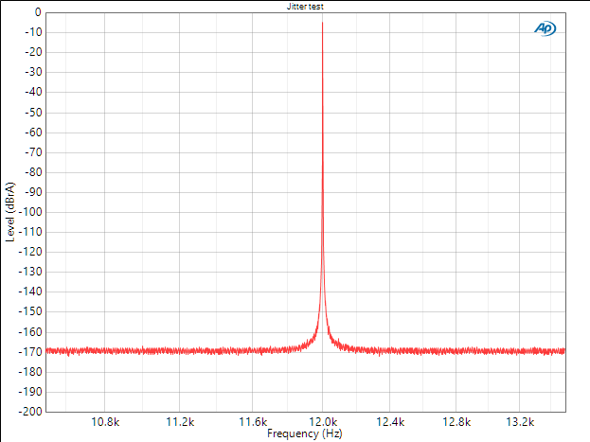
Jitter test
No measurable jitter artefacts

Slide 11
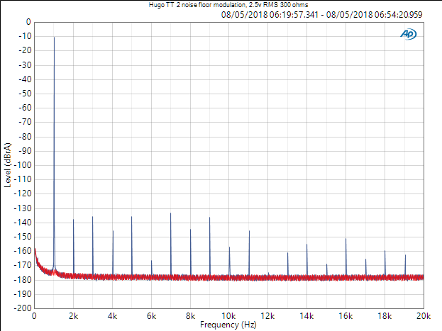
Measurements of Noise Floor Modulation
Blue trace is 2.5 V 1kHz 300 ohms
Red trace is zero signal
No measurable noise floor modulation – noise floor is static at -178 dB
Distortion is only 0.00008%
High order harmonics are all below -150 dB

Slide 12
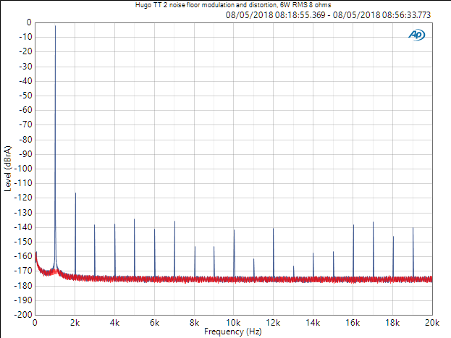
Measurements of Distortion into 8 ohms
Blue trace is 6 W RMS 1 kHz 8 ohms
No measurable noise floor modulation
Distortion barely increases to 0.00016%
High order harmonics are all below -138 dB
No sign of crossover distortion at all – due to the 2nd order analogue noise shaper amplifier

Slide 13
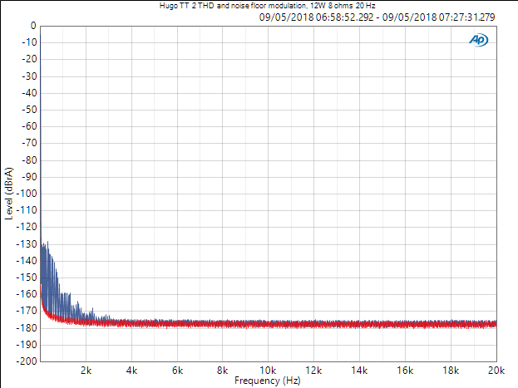
Distortion into 8 ohms with 20 Hz 12 W
Blue trace is 12 W RMS 20 Hz 8 ohms
No measurable noise floor modulation
No distortion whatsoever above 3 kHz
These remarkable results explains TT 2’s smooth and natural sound quality

Slide 14
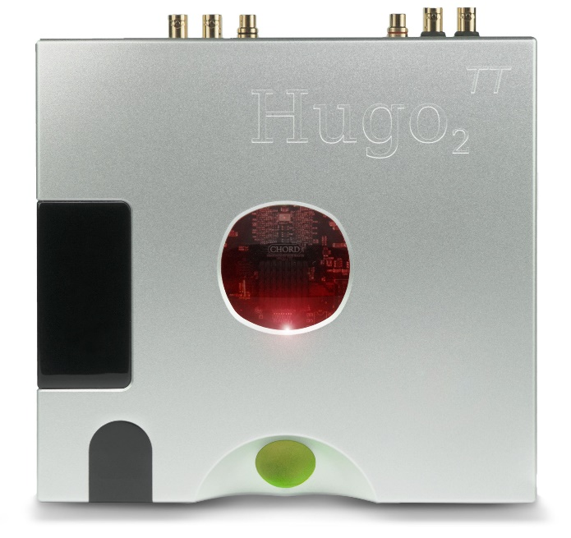
And finally...
Hugo TT 2 sets new standards for measured performance – Dave is the only DAC at all that beats it
Hugo TT 2 is the new sound quality reference for driving “impossible” headphones and efficient loudspeakers
Super-cap PSU gives huge dynamic current reserves
Thank-you for reading this presentation
Copyright Rob Watts 2018

