Slide 1


M Scaler
An introduction to Rob Watts’ M scaler technology
Copyright Rob Watts 2018

Slide 2
Perception – timing and location
Timing is an essential perceptual cue – transients are very important
The brain has a tapped delay line with neurons firing with a resolution of about 4uS
This is used as one perceptual cue for left to right (lateral) placement
The brain calculates placement to within 2 degrees
It also calculates depth perception to extraordinary precision
The 4uS threshold implies that the brain samples data at 250kHz – much faster than CD

Slide 3
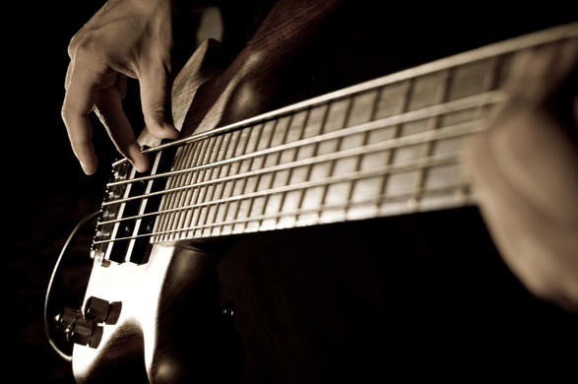
Perception – transients and bass
Perception of bass pitch by the ears is poor
The brain calculates bass pitch from starting transients
Remove the transients and it’s difficult to follow the bass tune – one can’t perceive bass pitch

Slide 4
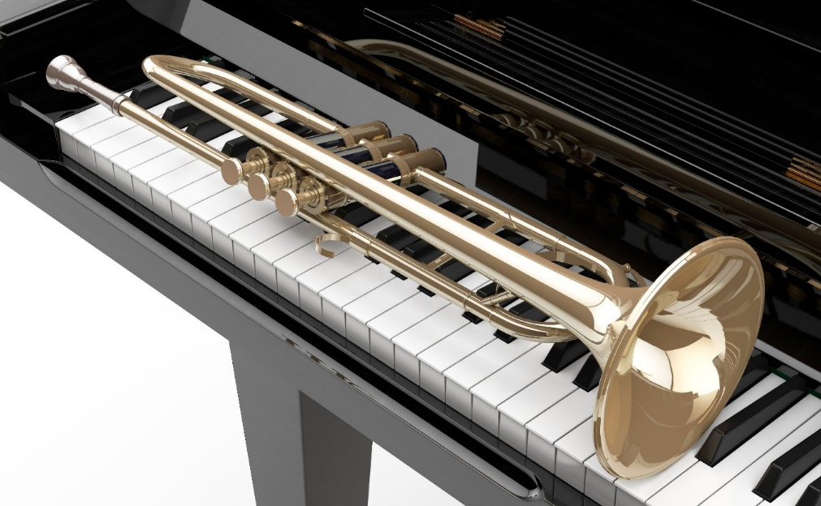
Perception – transients and timbre
Perception of timbre depends upon transients
Remove the transients and it becomes very difficult to tell the difference between a trumpet and a piano.

Slide 5
Why is digital audio so bad?
It’s all in the timing of transients
  We perceive pitch from transients
  We perceive sound stage from transients
  We perceive timbre from transients
  We perceive starting and stopping of notes from transients
Digital audio’s Achilles heel is the timing of transients
  CD timing resolution is 22 uS, but the ear/brain can resolve 4uS
  Very small timing errors have very big subjective impact
  Timing is reconstructed by the DAC’s interpolation filter
  Conventional DACs have timing uncertainty due to limited processing

Slide 6
Simple illustration of timing problem
Imagine sine wave transient – a burst signal
Sample it at the start of the transient and we get this digital data

Slide 7
DAC output from transient signal
Simple filter has transient timing errors of over 100uS, with peak errors of at full amplitude
This applies to NOS, IIR, MQA and minimum phase interpolation filters
Infinite processing sinc filter will perfectly reconstruct the original bandwidth-limited signal

Slide 8
Timing with Digital Audio
How is the timing of the original transients preserved if CD is sampling at 22uS?
  The interpolation filter re-creates the missing bits between samples
  Whittaker-Shannon sampling theory proves that with an infinite tap length FIR sinc filter then the “missing bits” will be perfectly reconstructed

Slide 9
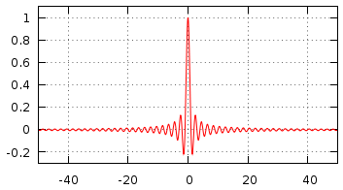
Reconstruction of timing
Sampling theory is absolute – if you use a Whittaker-Shannon interpolation filter it will perfectly reconstruct the original continuous analogue signal – with zero timing of transients error
Whittaker-Shannon needs a sinc impulse response but this requires an infinite tap length, infinitely oversampled, FIR filter
A tap length tells you how complex the interpolation filter is, and to perfectly reconstruct you must have infinite taps
The WTA filter algorithm has been designed and optimised with thousands of listening tests to maximise timing reconstruction accuracy with real world tap lengths
Sinc impulse response for time for 100 samples – the response becomes zero at infinity

Slide 10
Reconstruction of timing – filter algorithm
The filter algorithm can be created to improve timing accuracy making best use of available tap length
The WTA algorithm is a unique windowing function that is intended to minimize transient timing errors
It has been improved over 20 years, with many listening tests to optimize the sound quality
The algorithm is very much closer to an ideal sinc function than all other windowing functions

Slide 11
WTA filter tap length history
1024 taps – DAC 64 - 1999
18,000 taps – QBD76 - 2008
26,000 taps – Hugo - 2013
164,000 taps – Dave - 2015
Each increase in tap length together with continuous improvements to the WTA algorithm has given much better sound quality
Much better bass definition (being able to follow the tune), improved sound-staging, instrument separation and focus, more varied instrument timbre
You can perceive the starting and stopping of notes much more easily

Slide 12
My 35 year Mission Impossible
I studied electronics as a science degree in 1979-83
I also had researched the physiology of hearing, when it was apparent that transients were a major factor for perception of music
Shannon sampling theory was studied in depth in 1981
It was apparent to me that reconstruction using conventional filters would create transient timing errors
My prediction – 1 M taps was essential for digital to sound good, as this allows 16 bit interpolation accuracy
1 M taps in 1981 was utterly impossible

Slide 13
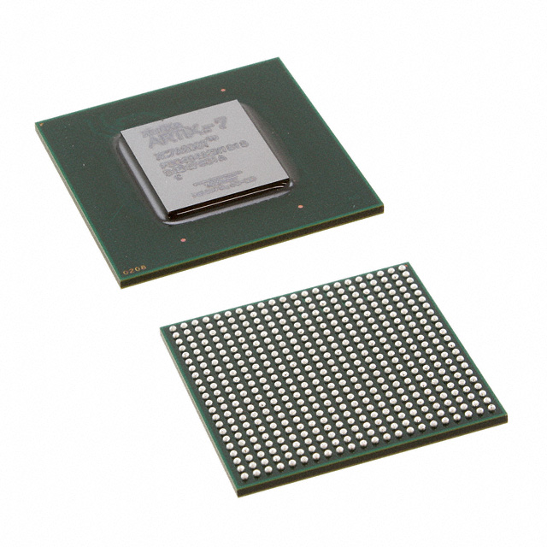
New FPGA – Xilinx XC7A200T
Only recently available in production quantities
740 DSP cores
215,360 logic cells
16Mb total memory
This device allows 1,015,808 WTA taps, thus meeting my 35 year Mission Impossible…

Slide 14
Why 1M taps on the M Scaler?
With 1M taps the WTA filter is identical to the ideal sinc function filter to a better than 16 bit accuracy
This means that reconstruction is guaranteed to be more than 16 bit accurate – even the best DACs today are only 2 or 3 bits accurate with reconstruction
Initial testing with 512,000 taps gave a surprisingly large SQ improvement on 164,000 – so pushing to the limit was rewarding
Getting 1M taps was extremely challenging – I needed to develop a completely new filter architecture to ensure max memory efficiency and for the FPGA to run fast enough

Slide 16
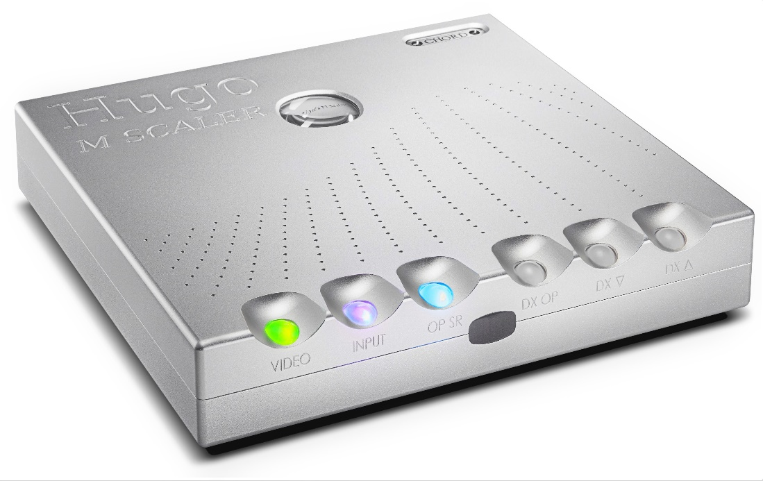
Hugo M Scaler
Full 1,015,808 WTA taps
Multiple inputs – galvanically isolated USB, two BNC, two optical
Dual BNC 44.1 kHz to 768 kHz outputs galvanically isolated
Single BNC 44.1 to 384 kHz output, optical 44.1 to 192 kHz output too
Adjustable sample rate OP, with pass-thru mode

Slide 17
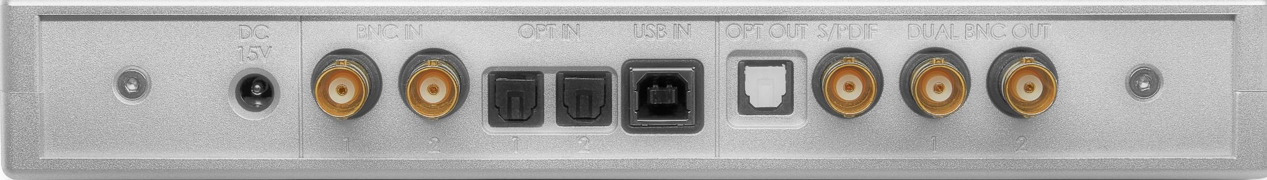
Hugo M Scaler features
Video mode for lower delay
Auto modes for video and source selection
Remote control
DX mode for volume and HF filter control for connection to future DX power amps
Powers from 9 to 15v – portable battery bank can power it

Slide 18
WTA M Scaler
The World’s most advanced filter technology
Redefines sound quality from digital
Timing of transients accuracy to a completely unprecedented level – better than 16 bit accuracy of re-creating the original un-sampled analogue signal
Thank you
Copyright Rob Watts 2016-2018

